Slide 1

Compare Pricing and Format Options
Select “Find Course Materials”

Slide 2
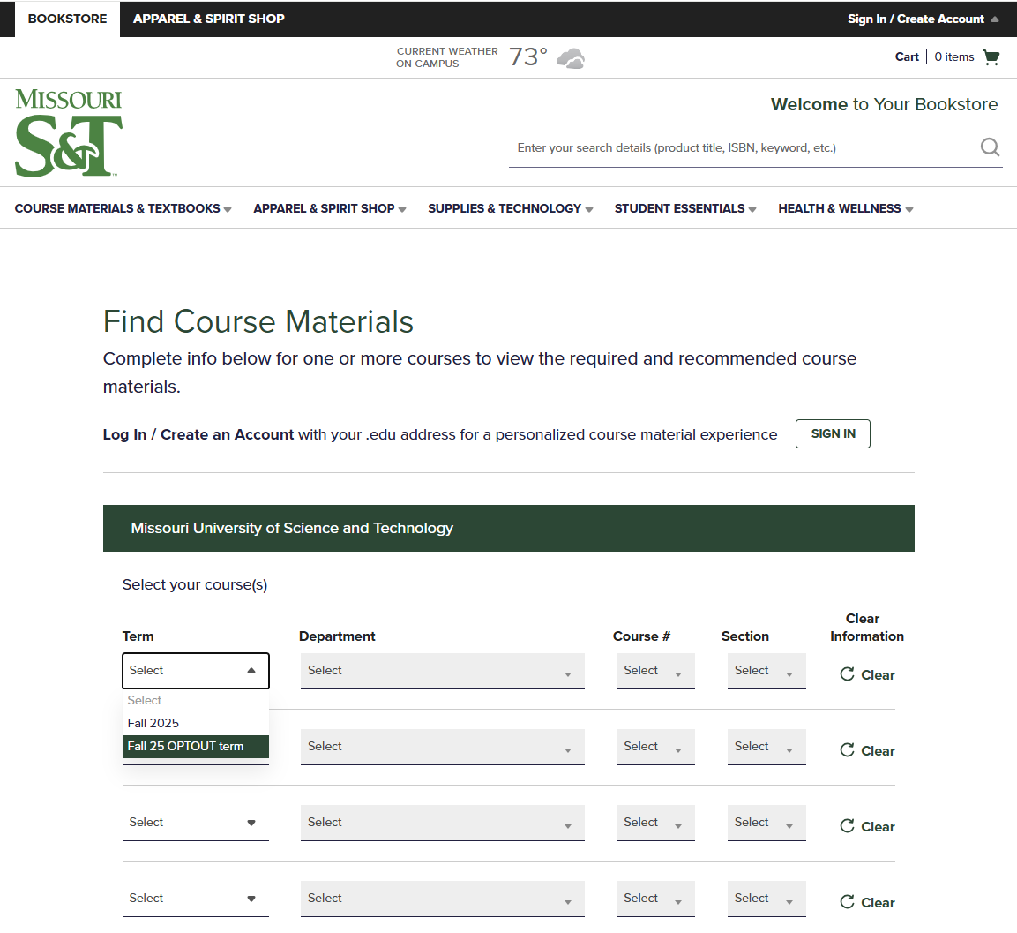
Compare Pricing and Format Options
Select “OPTOUT” term from the term selector

Slide 3
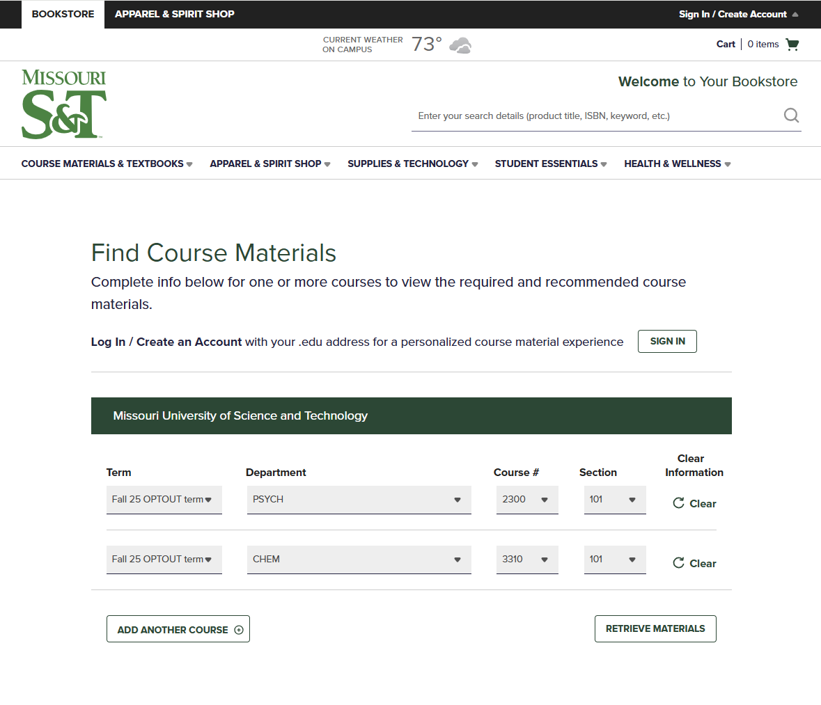
Compare Pricing and Format Options
Add Department, Course #, and Section Information

Slide 4
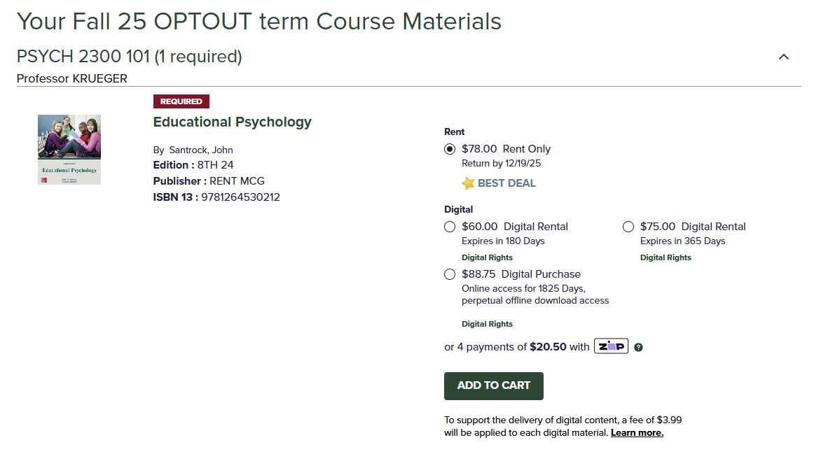
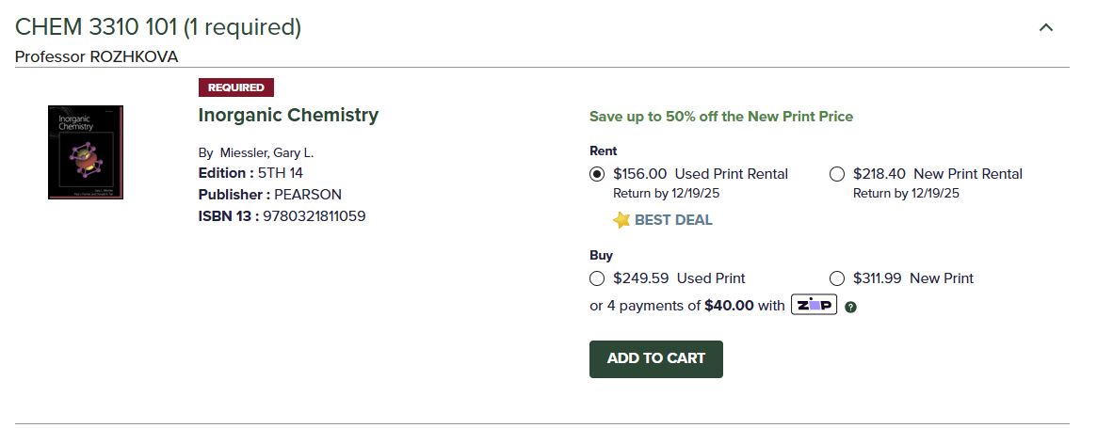
Compare Pricing and Format Options
See all available formats and pricing availability

